Slide 1
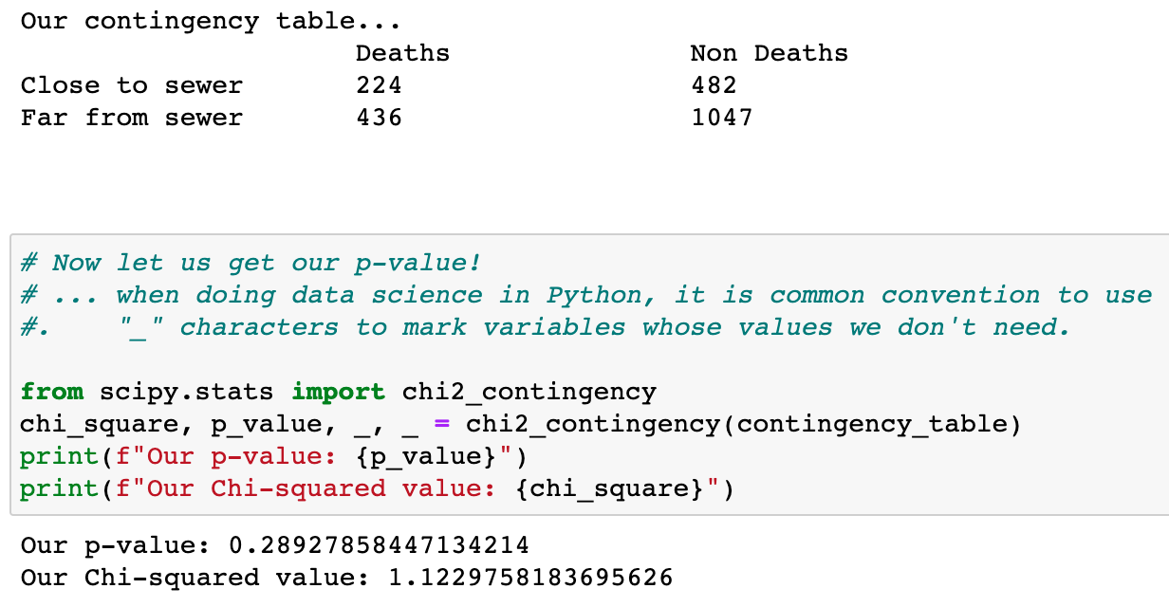
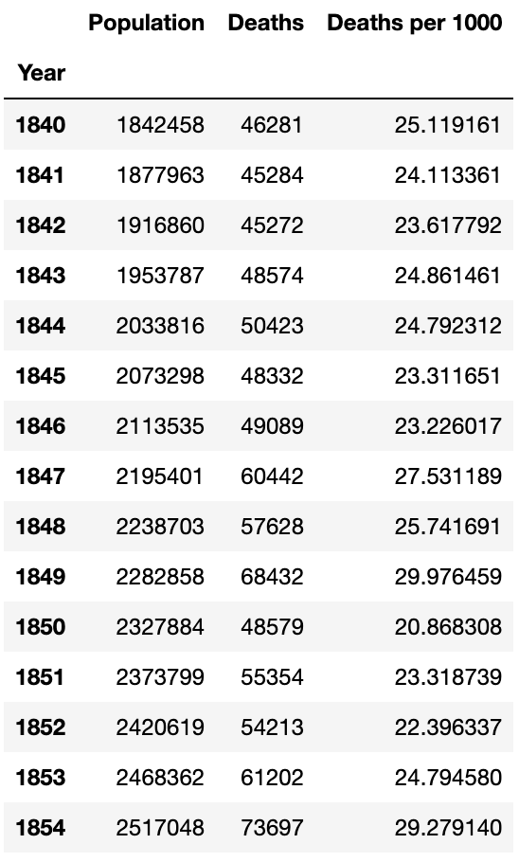
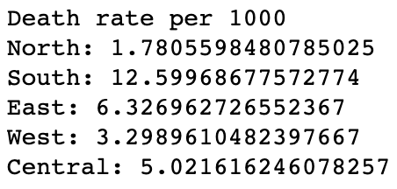
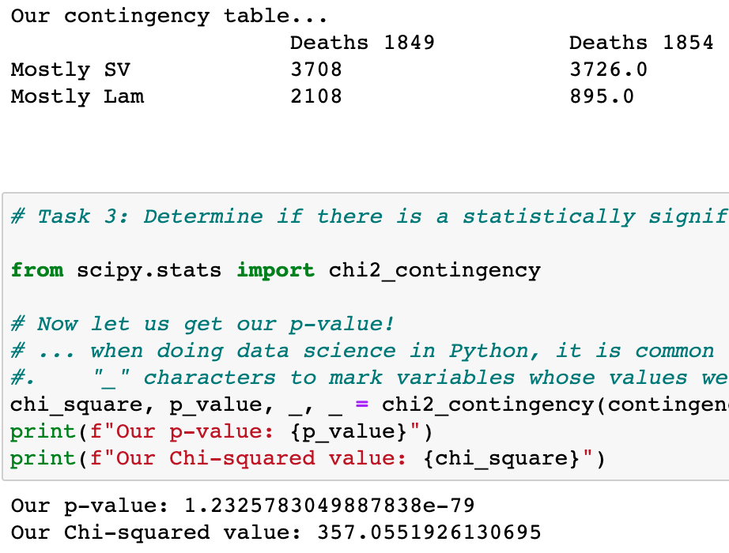
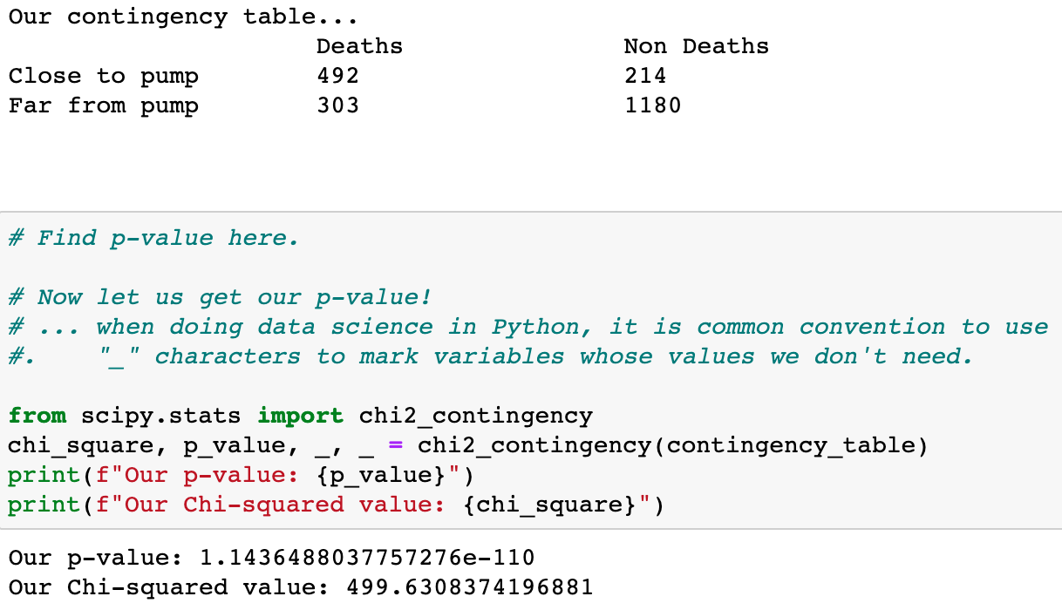

Slide 2
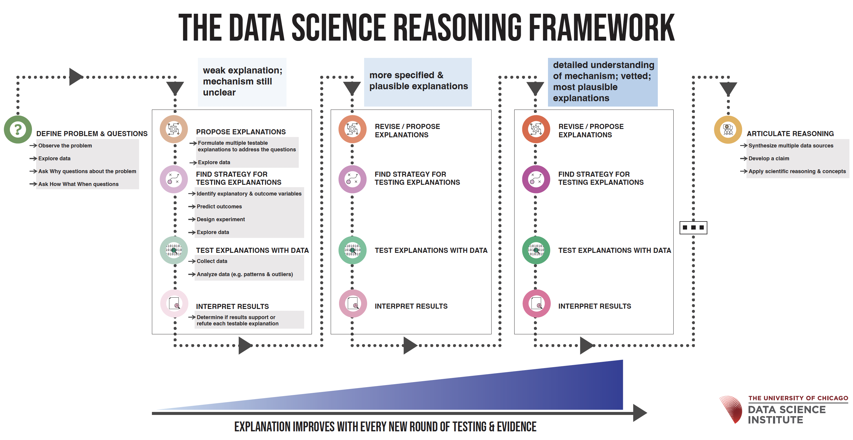

Slide 3
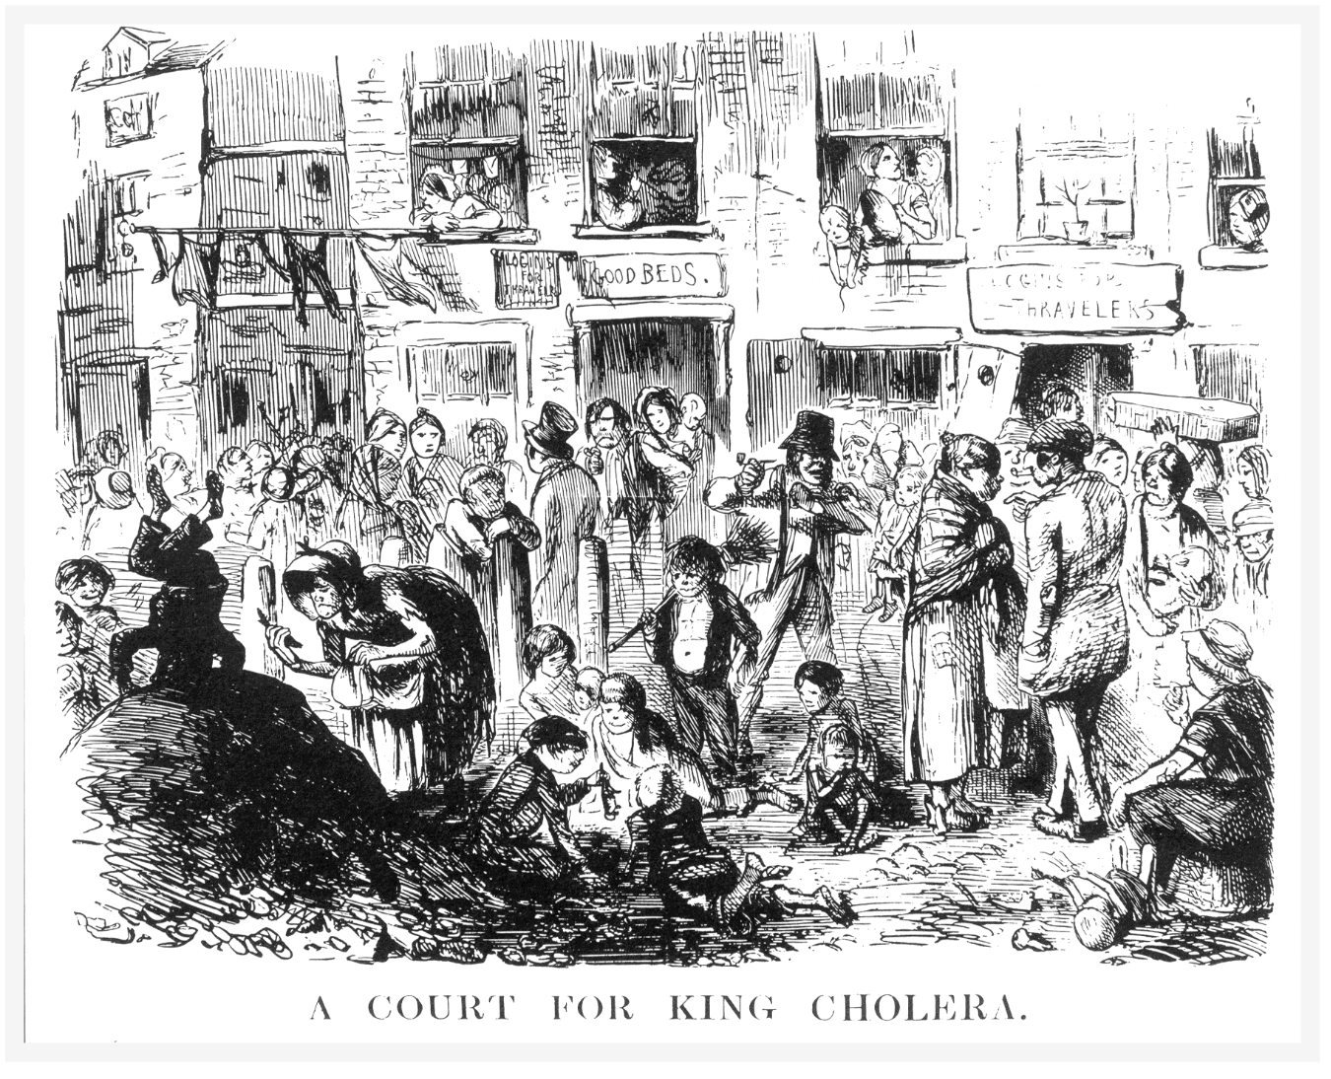

Slide 4
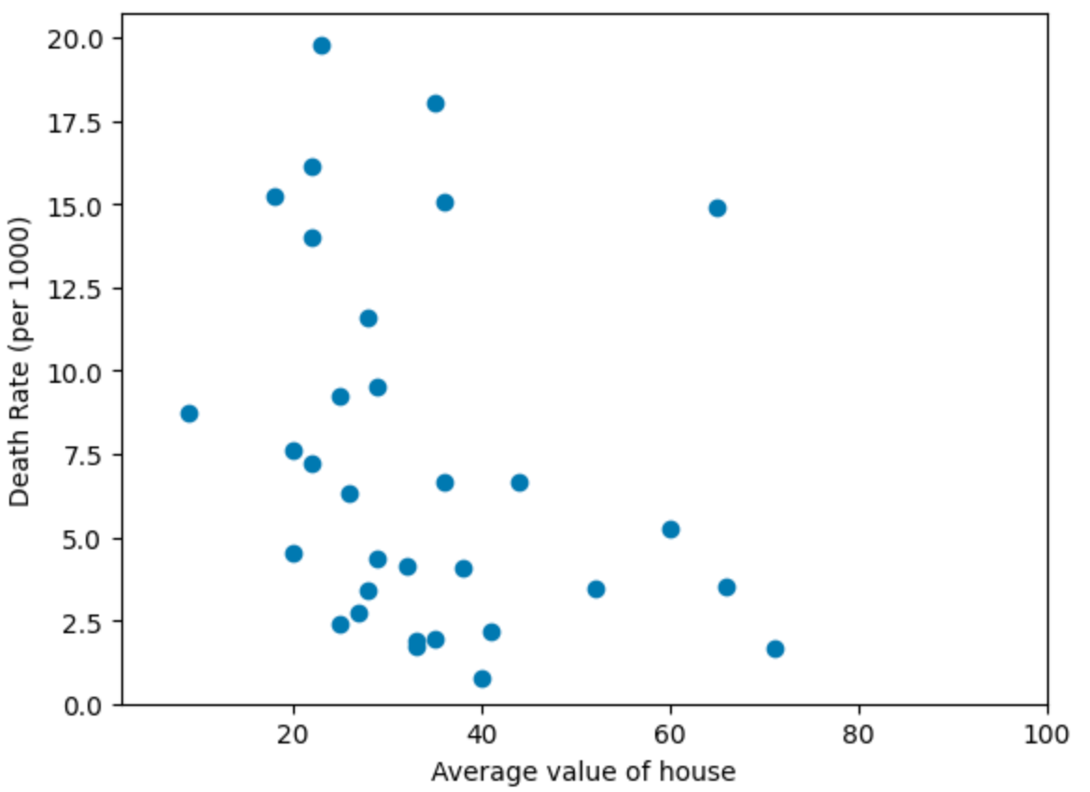
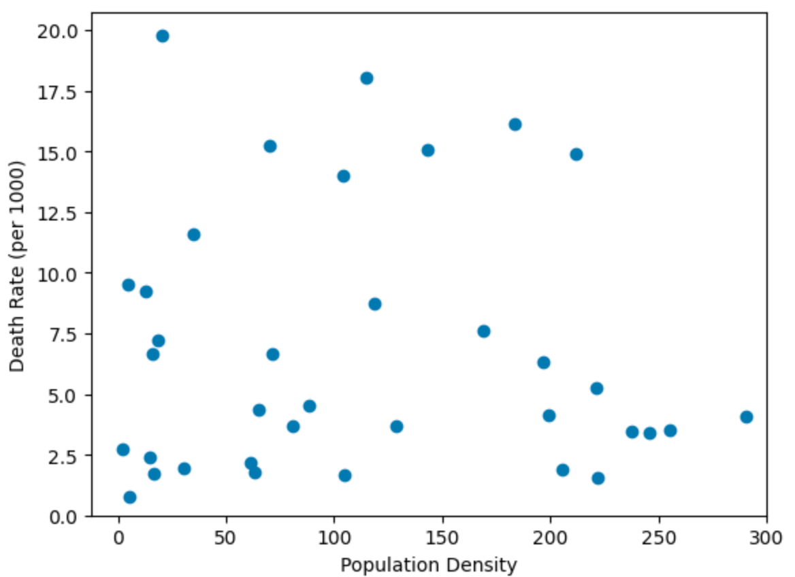
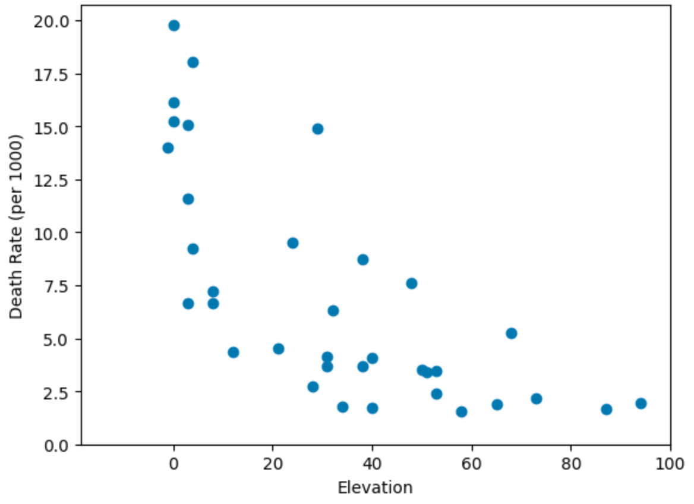
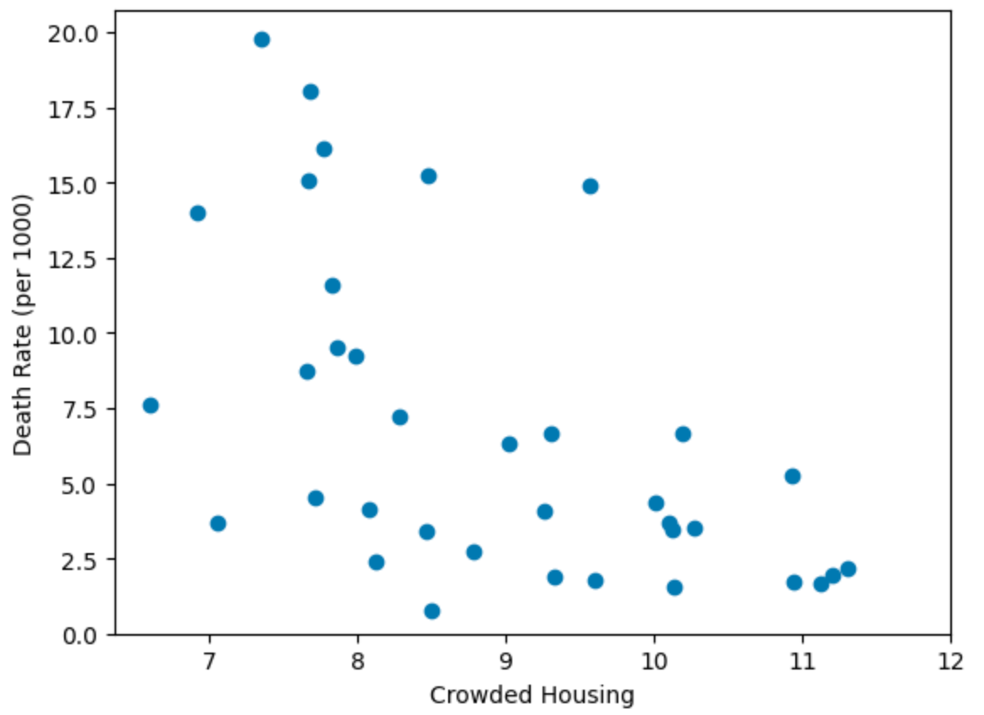

Slide 5
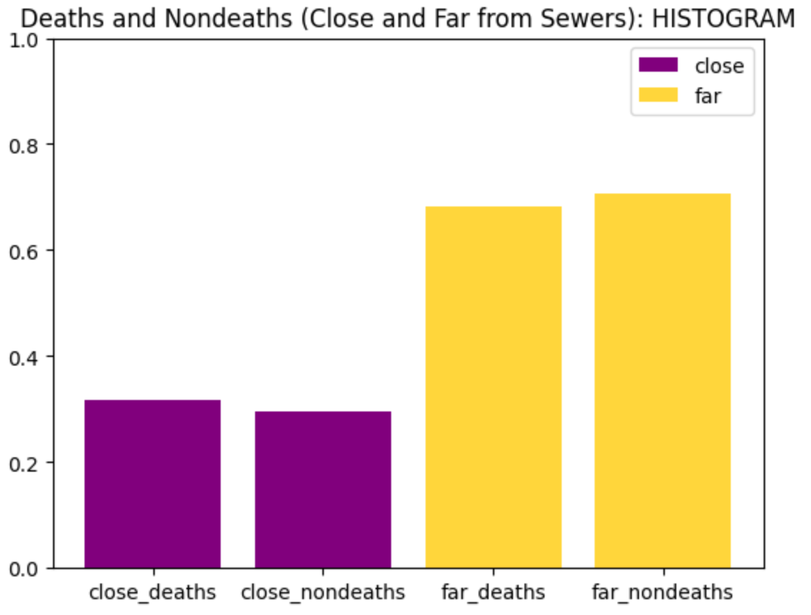
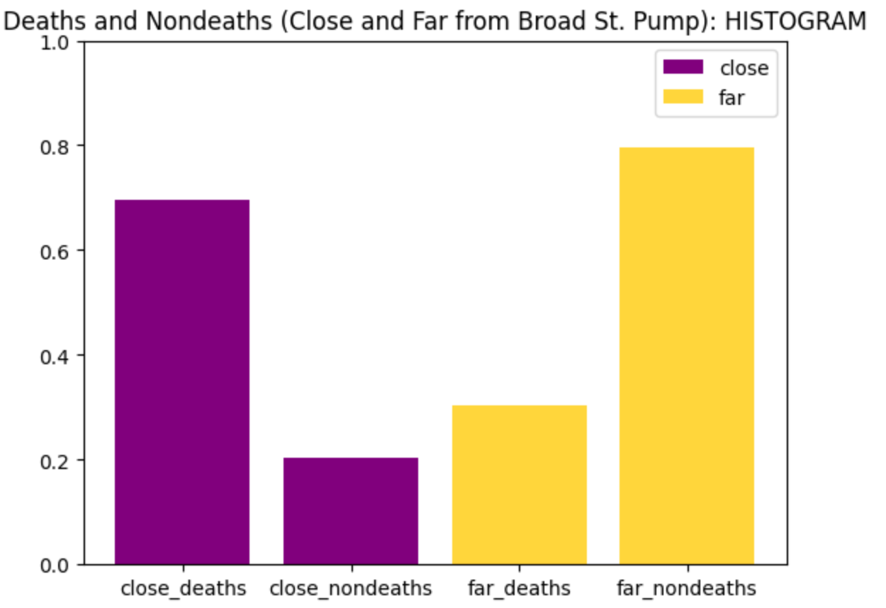
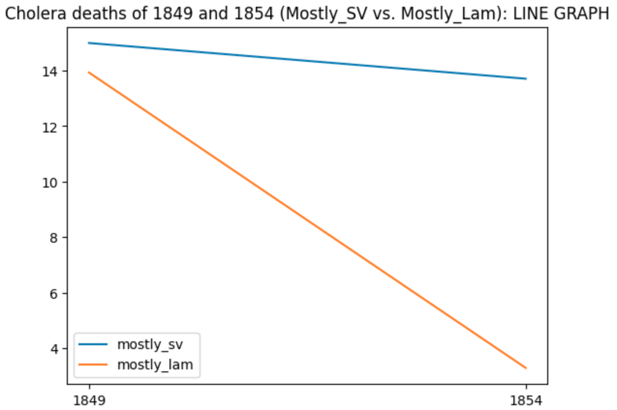
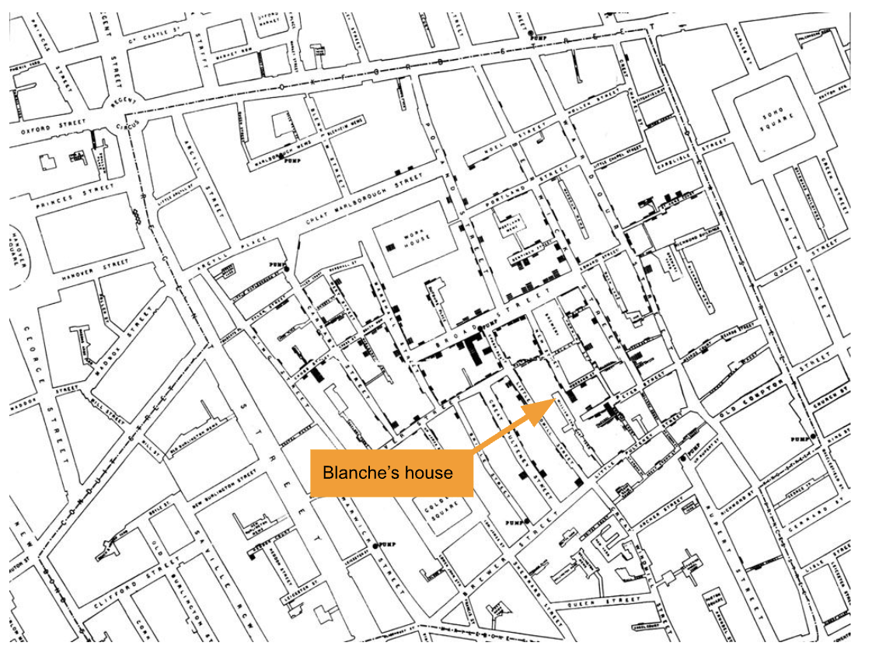

Slide 6
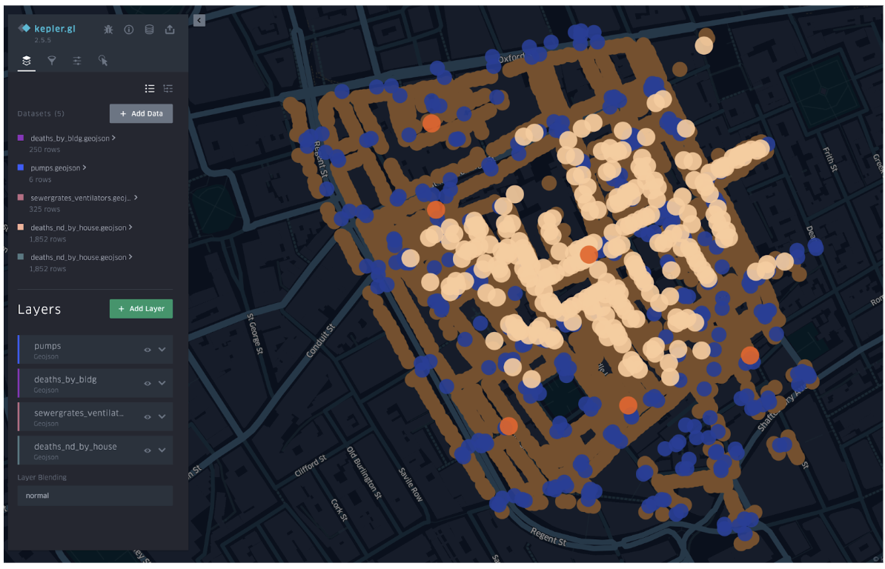
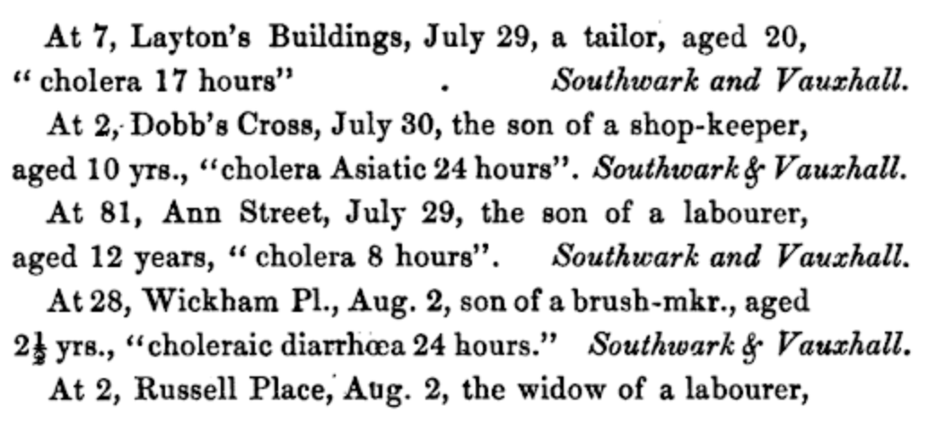
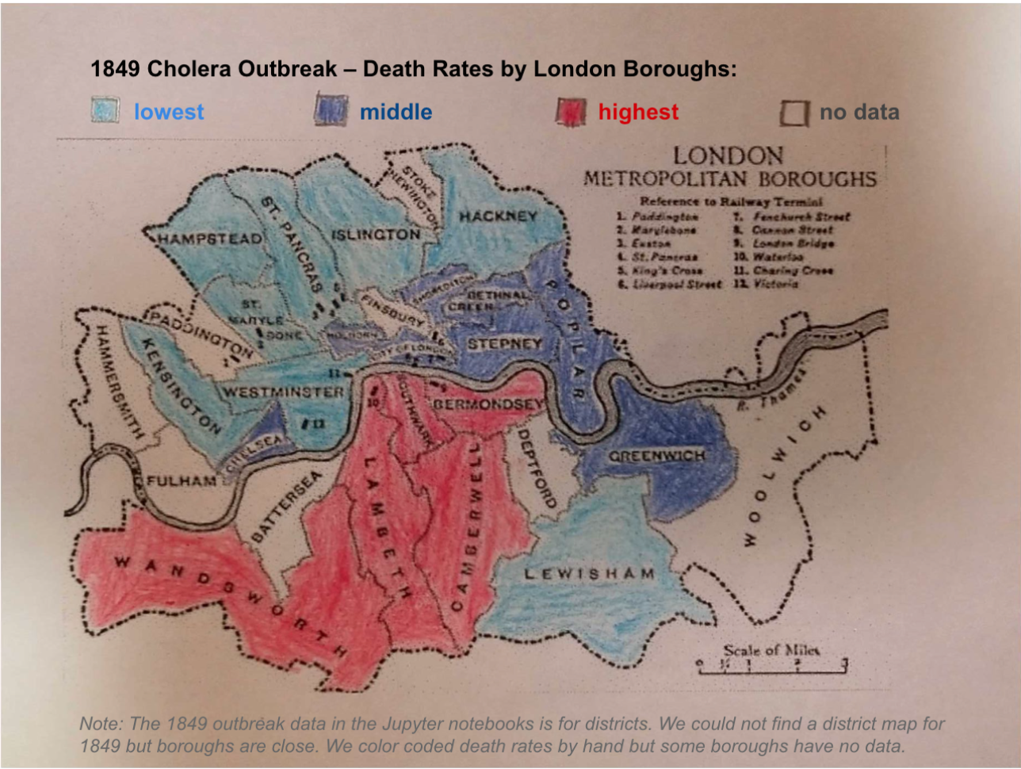
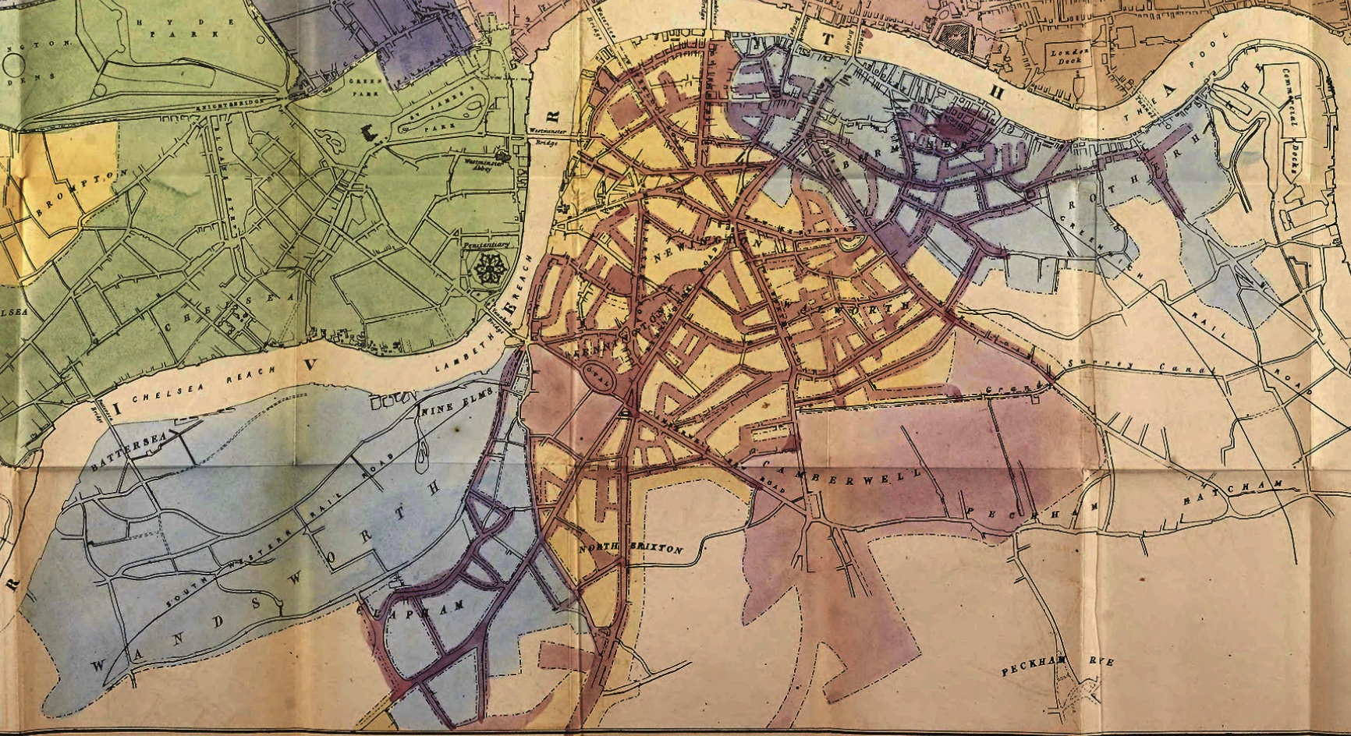

Slide 7
Near Sewer
Far from Sewer
Deaths
Houses that were near a sewer and had people that died from cholera
Houses that were far from a sewer and had people that died from cholera
Total houses that had deaths from cholera
Non-Deaths
Houses that were near a sewer that did not have deaths from cholera
Houses that were far from a sewer that did not have deaths from cholera
Total houses that did not have deaths from cholera
Total houses that were near a sewer
Total houses that were far from a sewer
Total houses

Slide 8
Near the Broad Street Pump (BSP)
Far from the Broad Street Pump (BSP)
Deaths
Houses that were near the BSP and had people that died from cholera
Houses that were far from the BSP and had people that died from cholera
Total houses that had deaths from cholera
Non-Deaths
Houses that were near the BSP that did not have deaths from cholera
Houses that were far from the BSP that did not have deaths from cholera
Total houses that did not have deaths from cholera
Total houses that were near the BSP
Total houses that were far from the BSP
Total houses

Slide 9
Subdistricts supplied mostly by Lambeth
Subdistricts supplied mostly by Southwark & Vauxhall
Deaths in 1849
Deaths in subdistricts supplied by Lambeth in 1849
Deaths in subdistricts supplied by Southwark & Vauxhall in 1849
Deaths in 1854
Deaths in subdistricts supplied by Lambeth in 1854
Deaths in subdistricts supplied by Southwark & Vauxhall in 1854

